Slide 1

Analysis of Homes sold Above median value in Ames, Iowa: Subbu Subramanian

Slide 2

Project analysis slide 2
Initial Analysis
As Per the initial analysis of the Home sales Data in Ames, Iowa, 51% of the Homes were sold above the Median value. While there are several factors provided in the sales data which determines the value of the home, there are only a few of them seems to be significant – Zones, Lot Area, Neighborhood, Type of Building, Year Built, Year Remodeled, Living Area, Number of rooms above Ground level and the Garage capacity.
Let's Analyze in detail in the upcoming slides on the significance of these different variables and their contribution to a Home being sold Above or Below Median value:

Slide 3
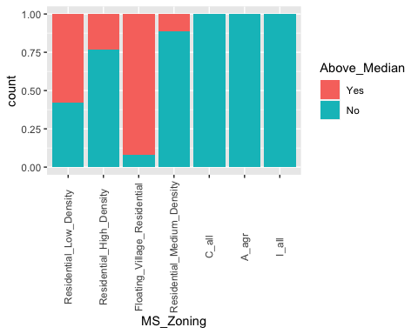
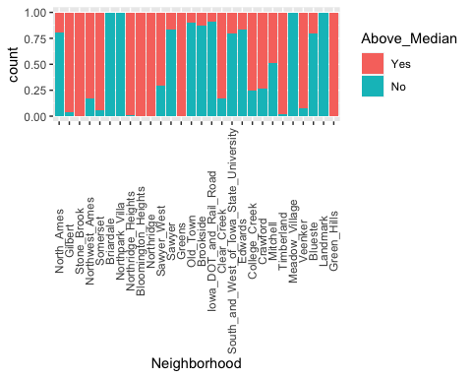
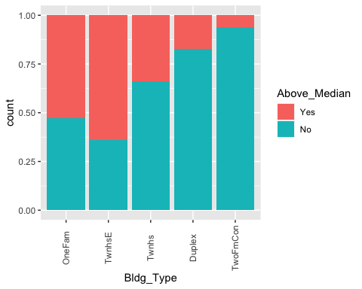
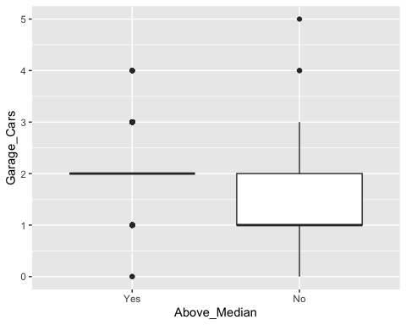
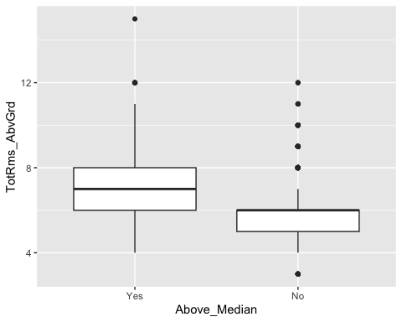
Project analysis slide 2
Significant Factors
Zone Based Analysis
Neighborhood Based Analysis
Building Type Based Analysis
Rooms Above Ground Based Analysis
Car Garage Capacity Based Analysis

Slide 4
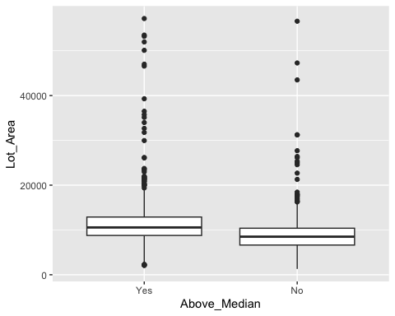
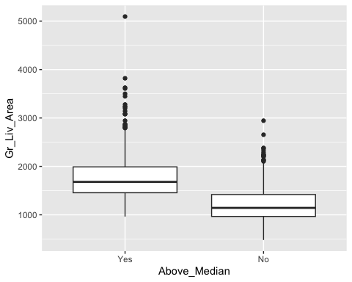
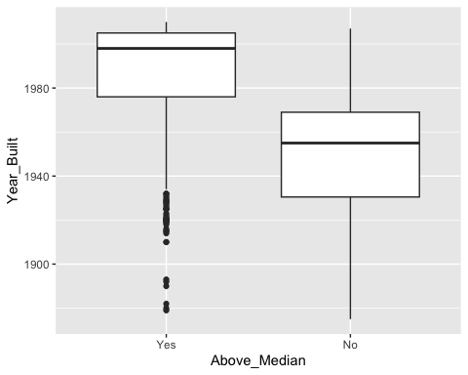
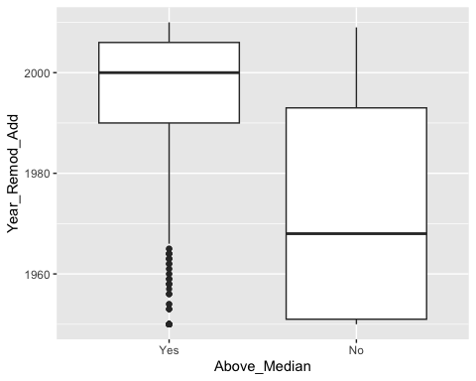
Project analysis slide 2
Supportive Factors
Lot Area Based Analysis
Living Area Based Analysis
Built Year Based Analysis
Remodeled Year Based Analysis

Slide 5

Project analysis slide 2
Finalizing the Analysis
As evident from the analysis so far, Neighborhood – College Creek, Somerset, Gilbert, Northwest Ames and North Ames, Zoning – Low Density Residential Area and Type of Building – One Family Homes, plays a significant role in the price of homes which were sold Above Median value.
When we further drill down, College Creek Neighborhood has the greatest number of homes sold above median value.

Slide 6
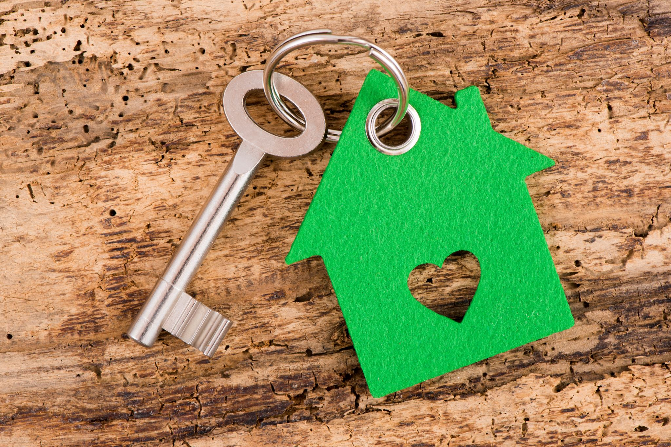
Project analysis slide 2
Summary
Highest number Homes in College Creek neighborhood are the ones which are sold above median value. These above median value homes are all of One Family homes with a Low-Density Residential Zoning. They all have been built on a median lot area of 10142 sq.ft with a median living area of 1661 sq.ft. All these homes are either mostly built after 2002 or remodeled after 2003. Two car garages are a minimum for these homes, and they have a median of 7 rooms above ground level.
Summarizing the top 5 Variables which determines the values of a home being sold above Median Value in Ames:
Living Area
Year Built
Neighborhood
Car Garage Capacity
Zone

Slide 7
Thank You

